Slide 1


Will the Rocket Fly?
Dongwei Wu
15 December 2021

Slide 2

Outline
Executive Summary
Introduction
Methodology
Results
Conclusion
Appendix

Slide 3
Executive Summary
This project aims to develop an algorithm for predicting the probability of successful rocket launches to help with SpaceY’s plan to launch rockets
Summary of methodologies - I collected data on SpaceX’s Falcon 9 rocket launches using SpaceX’s API and the Beautiful Soup, processed the data using Numpy, explored the data and extracted features using Matplotlib and Seaborn and finally fed the processed data into various predictive algorithms in the scikit-learn library to determine which algorithm performs the best.
Summary of all results – the best algorithm as measured by the accuracy score of the algorithm’s prediction on test data is the decision tree algorithm with the decision criteria of entropy and maximum depth of 12. The algorithm accuracy on test data is an astonishing 94.44%.

Slide 4
Introduction
Background – SpaceY is a start-up in the rocket business. It would like to estimate the cost of a launch. A crucial piece of this puzzle is the probability of a successful launch where a part of the rocket gets to be recycled. SpaceY therefore needs a reliable algorithm to predict the probability of such success.
Problem – an algorithm which can reliably predict the probability of a successful rocket launch whereby the first stage of the rocket is recycled.

Slide 5


Slide 6
Methodology
Executive Summary
Data collection methodology:
Data on rocket launches are collected using the request library and SpaceX API from SpaceX’s website as well as using the Beautiful Soup library from the following Wikipedia page - https://en.wikipedia.org/wiki/List_of_Falcon\_9\_and_Falcon_Heavy_launches
Perform data wrangling
A dummy variable “class” is created to signify the success or failure of a launch. Only data relating to launches using a Falcon 9 booster are kept.
Perform exploratory data analysis (EDA) using visualization and SQL
Perform interactive visual analytics using Folium and Plotly Dash
Perform predictive analysis using classification models
Data were standardized, split and fed to SVM, decision tree, logistic regression and k-nearest neighbors algorithms through grid-search.

Slide 7
Data Collection
Data Collection – SpaceX API
Data Collection - Scraping

Slide 8
Data Collection – SpaceX API
Request past launch data using SpaceX API
Normalize the response using Panda’s Json normalisation method
Apply extraction functions to each cell of the data table from and save extracted data into a dictionary
Saved the dictionary into a Panda DataFrame
https://github.com/azurecode1119/IBD-data-science-professional-certificate-capstone-project/blob/main/SpaceX%20launch%20data%20collection.ipynb

Slide 9
Data Collection - Scraping
Request the raw html file of a Wikipedia page which contains data on past launches of SpaceX
Use Beautiful Soup’s findAll method to extract the html relating to all tables
Loop through the table html and save the relevant data in a Python dictionary
Save the dictionary into a Panda DataFrame
https://github.com/azurecode1119/IBD-data-science-professional-certificate-capstone-project/blob/main/Space%20X%20launch%20data%20collection%20using%20Web-scraping.ipynb

Slide 10
Data Wrangling
Filter the data to keep only data relating to launches using a Falcon 9 Booster
Inspect the column “Outcome” and determine which value represents success or failure
Insert a column named “Class” into the DataFrame which uses 0 and 1 to represent failure and success respectively
https://github.com/azurecode1119/IBD-data-science-professional-certificate-capstone-project/blob/main/EDA%20(Data%20Wrangling).ipynb

Slide 11
EDA with Data Visualization
Scatter Plot of Flight Number vs. Payload Mass
Scatter Plot of Flight Number vs. Launch Sites
Scatter Plot of Payload Mass vs. Launch Site
Bar Chart showing success rate of each orbit
Scatter Plot of Flight Number vs. Orbit
Scatter Plot of Payload Mass vs. Orbit
Line Chart of Year vs. Success Rate
https://github.com/azurecode1119/IBD-data-science-professional-certificate-capstone-project/blob/main/EDA%20with%20Data%20Visualization.ipynb

Slide 12
EDA with SQL
Display distinct launch sites
Display only launch sites in Cape Canaveral Space Force Station, Florida
Display the total payload mass carried by boosters launched by NASA (CRS)
Display average payload mass carried by booster version F9 v1.1
List the date when the first successful landing outcome in ground pad was acheived.
List the names of the boosters which have success in drone ship and have payload mass greater than 4000 but less than 6000
List the total number of successful and failure mission outcomes
List the names of the booster versions which have carried the maximum payload mass (sub-query used)
List the failed landing_outcomes in drone ship, their booster versions, and launch site names for in year 2015
Rank the count of landing outcomes (such as Failure (drone ship) or Success (ground pad)) between the date 2010-06-04 and 2017-03-20, in descending order
https://github.com/azurecode1119/IBD-data-science-professional-certificate-capstone-project/blob/main/EDA%20with%20SQL.ipynb

Slide 13
Build an Interactive Map with Folium
Add circles to the locations of each launch sites to indicate location as well as markers to indicate the names of the launch sites
Add marker clusters to indicate the number of launches, successes and failures
Add MousePosition to show the coordinate of where the mouse is on a map to facilitate the calculation of the proximity between the launch site and various landmarks
Add polyline to mark the straight line distance between certain launch site and its nearest coast, highway and city center
https://github.com/azurecode1119/IBD-data-science-professional-certificate-capstone-project/blob/main/Interactive%20Visual%20Analytics%20with%20Folium.ipynb

Slide 14
Build a Dashboard with Plotly Dash
Pie Chart to show the split of launches across all launch sites
Pie Chart to show the rate of success/failure in each launch site
Scatter Plot to show the correlation between success and payload mass with different color for each booster version to show its correlation with success
Summarize what plots/graphs and interactions you have added to a dashboard
https://github.com/azurecode1119/IBD-data-science-professional-certificate-capstone-project/blob/main/Interactive%20Dashboard.ipynb

Slide 15
Predictive Analysis (Classification)
Load the DataFrame and split it into the feature set and the label set
Standardize the feature set using sklearn’s StandardScaler
Split the dataset into the training set and testing set with a 80:20 ratio
Feed the data into four learning algorithms – SVM, K-nearest neighbours, logistic regression and decision tree.
For each algorithm, a grid search object was created so that different parameters are explored
The best parameters for each algorithm are found and the model was tested against the testing set
The model which performs the best on the testing set in terms of predictive accuracy is selected
https://github.com/azurecode1119/IBD-data-science-professional-certificate-capstone-project/blob/main/Predictive%20Analysis%20(Classification).ipynb

Slide 16
Results
Exploratory data analysis results
Interactive analytics demo in screenshots
Predictive analysis results

Slide 17


Slide 18
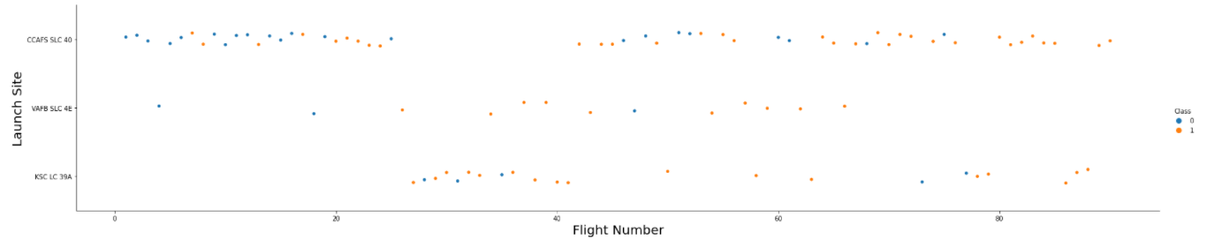
Flight Number vs. Launch Site
CCAFS SLC 40 has the greatest number of launches
Launches 1 to 25 and 40 to over 80 tend to happen in CCAFS SLC 40
Launches 25 to 40 tend to happen in KSC LC 39A

Slide 19
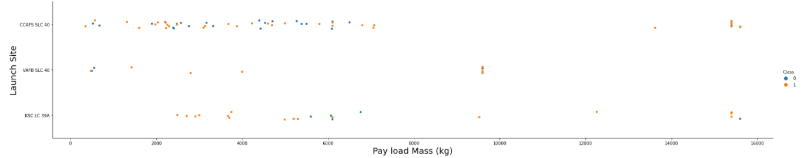
Payload vs. Launch Site
The heaviest pay loads are launched across CCAFS SLC 40 and KSC LC 39A, but not VAFB SLC 4E, which tends to launch payloads which are slightly below 10000kg
CCAFS SLC 40 handles a range of payloads from a few hundred kg to around 7000kg
At the lower end, KSC LC 39A tends to handle payloads between 2000kg and 7000kg

Slide 20
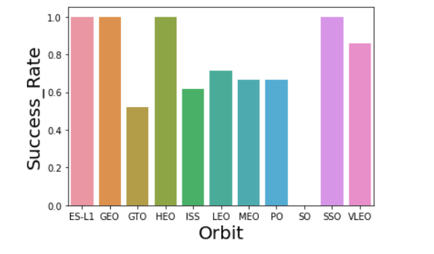
Success Rate vs. Orbit Type
Success rates for ES-L1, GEO, HEO and SSO are the perfect 100%
Success rate for GTO is the lowest, a 50% coin-flip,
Success rates for ISS, MEO, PO and LEO are between 60% and 70%

Slide 21
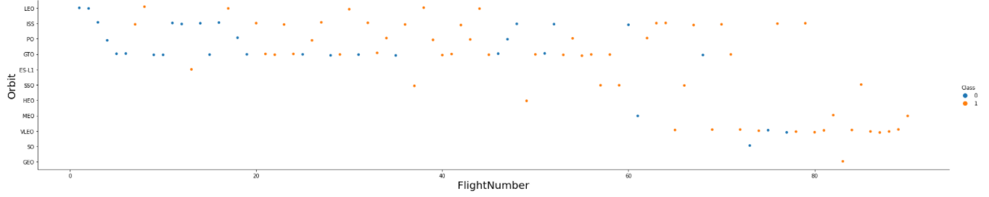
Flight Number vs. Orbit Type
The most frequently attempted orbit is GTO
Certain orbits are only attempted after 60 flights, such as VLEO, SO, GEO and MEO

Slide 22
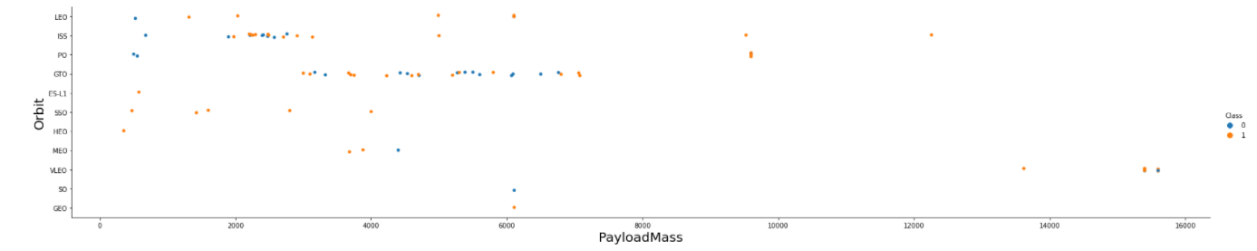
Payload vs. Orbit Type
The heaviest payloads (over 13,000kg) are all carried out on VLEO
The widest range of payloads are carried out on ISS (from 500kg to over 12,000kg)

Slide 23
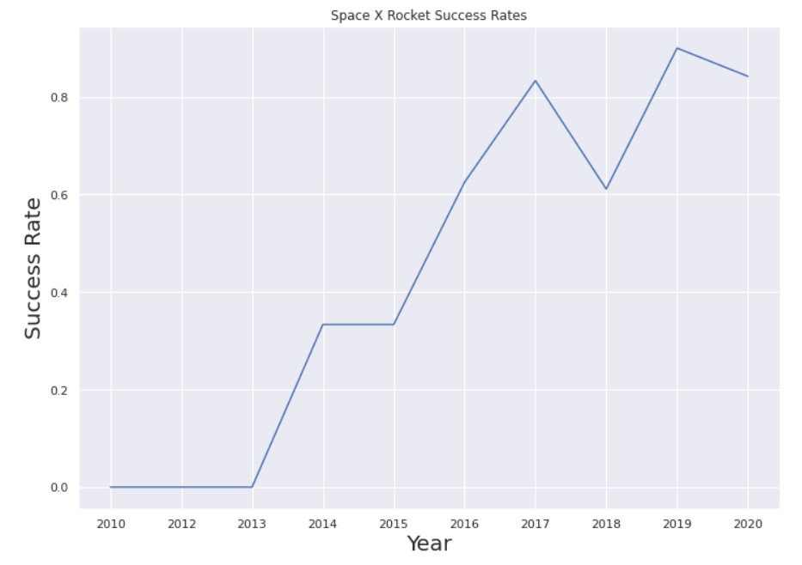
Launch Success Yearly Trend
The success rate increases in a linear fashion year-on-year from all failures to over 85% successes

Slide 24
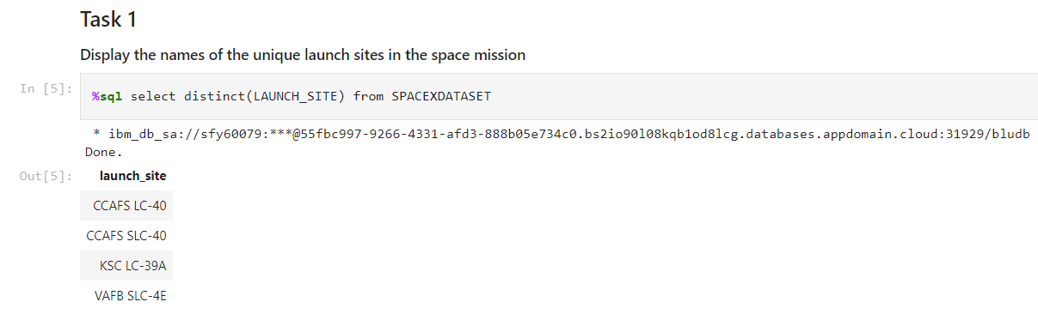
All Launch Site Names
‘%sql’ allow jupyter notebook to process SQL query
‘Select’ and ‘from’ returns data from a chosen dataset
‘distinct(column_name)’ keeps only the unique values in the column

Slide 25
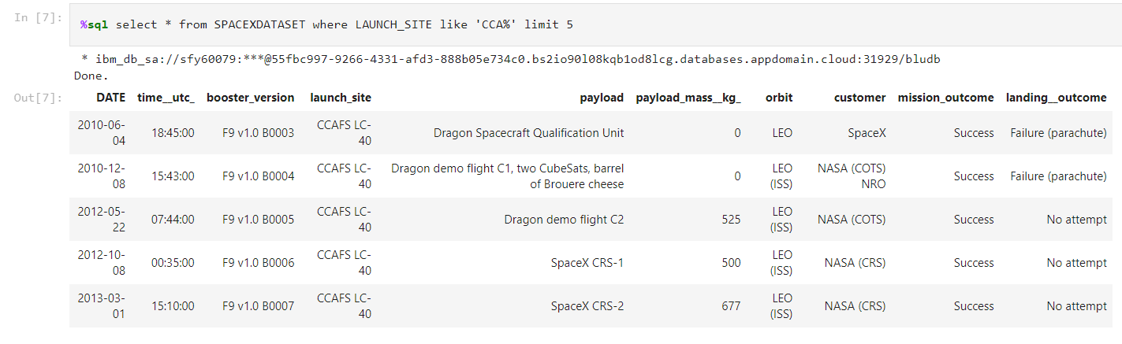
Launch Site Names Begin with 'CCA'
‘where’ specifies conditions for filtering the selected dataset
Column_name ‘like’ ‘value’ retains entries whose values follow the format in the specified value. ‘string%’ represents any value which start with ‘string’
‘limit’ keep the displayed data to only the top five rows selected

Slide 26
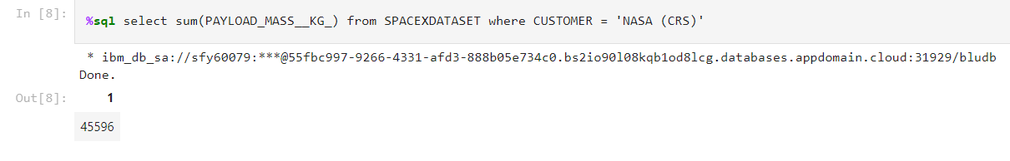
Total Payload Mass
‘sum(column_name)’ return the sum of all values in the column
‘= string’ evaluate whether the value matches exactly with ‘string’, in this case, the query only concerns data where the customer is NASA (CRS)

Slide 27
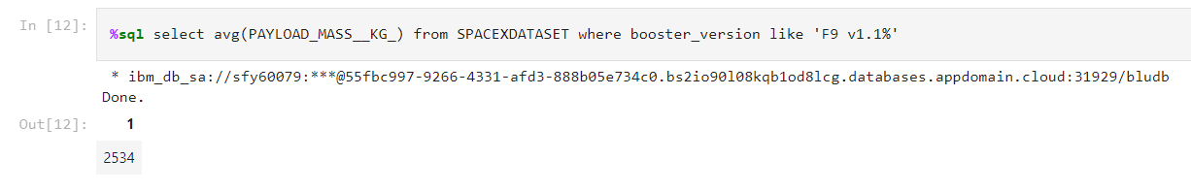
Average Payload Mass by F9 v1.1
‘avg(column_name)’ return the average of all values in the column
This query returns the average payload of all launches powered by the F9 v1.1 boosters

Slide 28
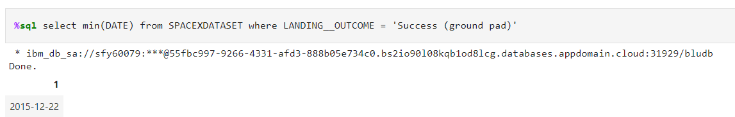
First Successful Ground Landing Date
‘min(column_name) returns the smallest value in the column
This query returns the earliest launch with a successful ground landing

Slide 29
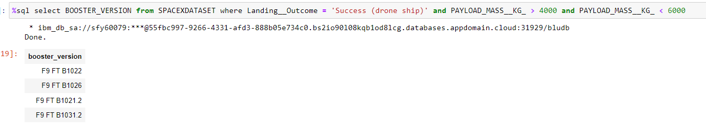
Successful Drone Ship Landing with Payload between 4000 and 6000
This query lists the names of boosters which have successfully landed on drone ship and had payload mass greater than 4000 but less than 6000
‘and’ adds further condition to the selection of data

Slide 30
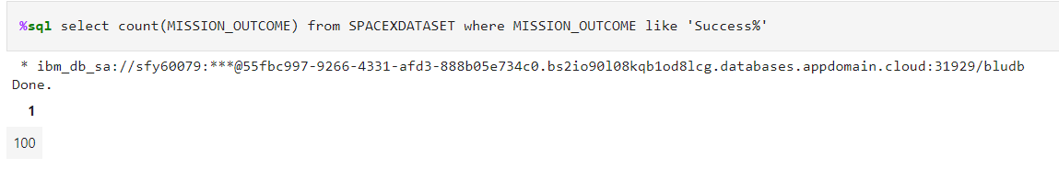
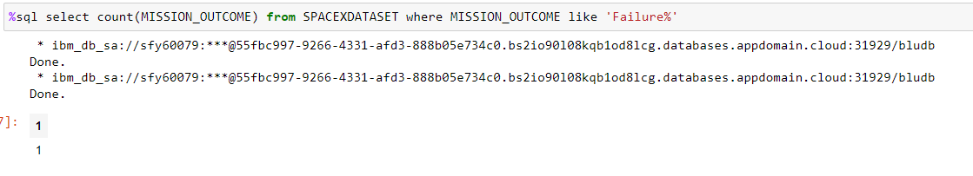
Total Number of Successful and Failure Mission Outcomes
These queries respectively return the total number of launches which succeeded and failed in completing the mission

Slide 31
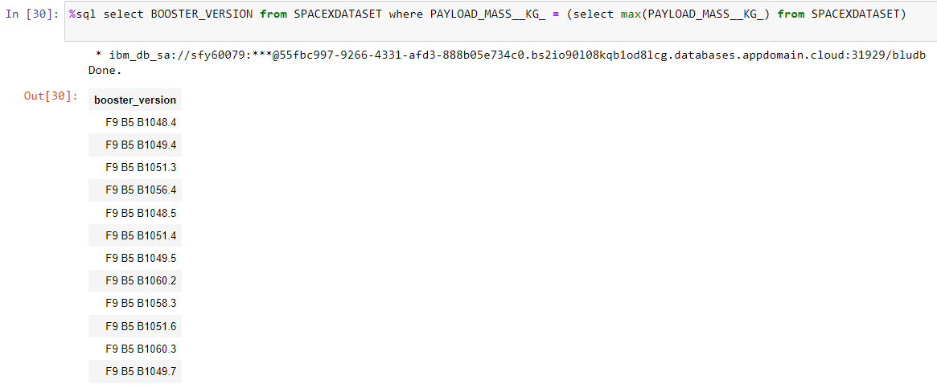
Boosters Carried Maximum Payload
List of boosters which have carried the maximum payload in all launches
‘Max(column_name)’ returns the highest value in the column

Slide 32
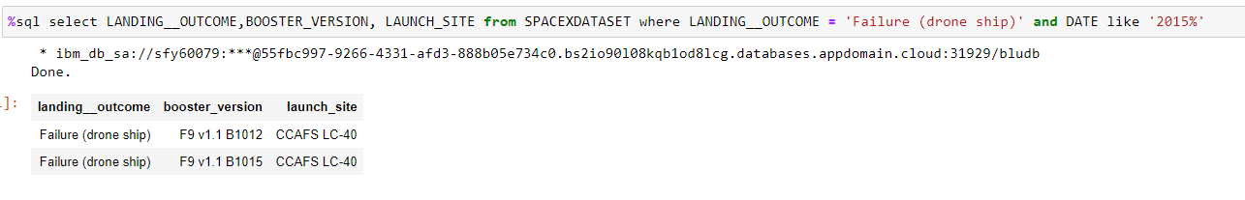
2015 Launch Records
List the failed landing_outcomes in drone ship, their booster versions, and launch site names for in year 2015

Slide 33
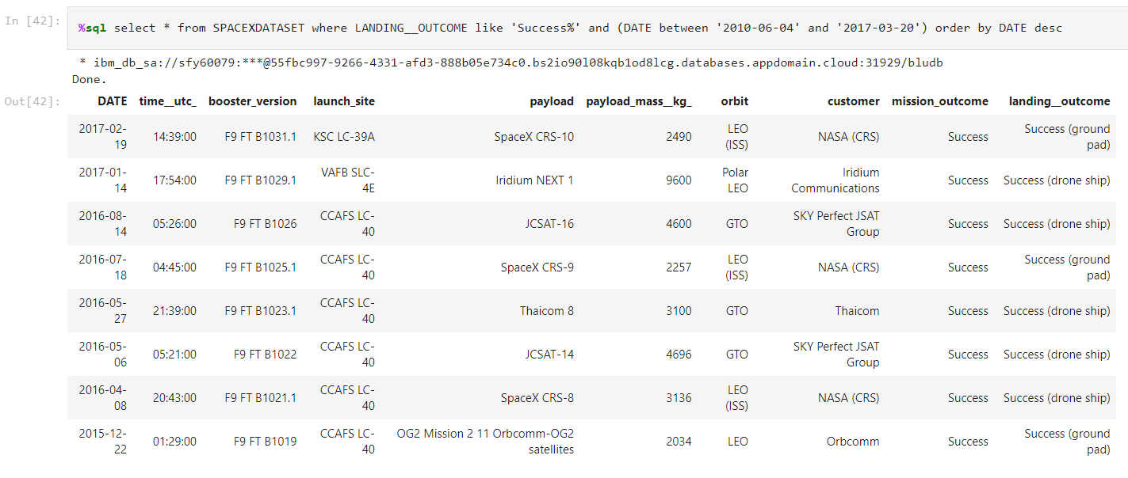
Rank Landing Outcomes Between 2010-06-04 and 2017-03-20
Rank the count of landing outcomes (such as Failure (drone ship) or Success (ground pad)) between the date 2010-06-04 and 2017-03-20, in descending order

Slide 34


Slide 35
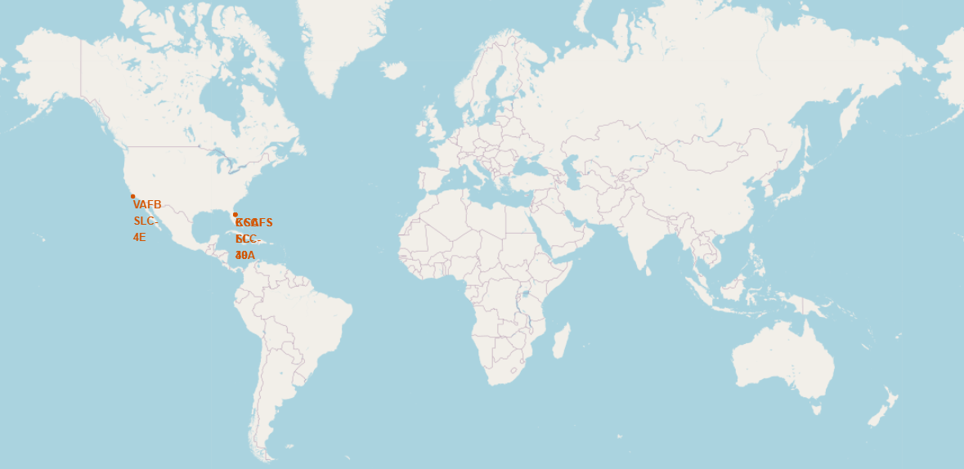
Locations of Launch Sites
All launch sites are set up in the U.S.A. and near a coast

Slide 36
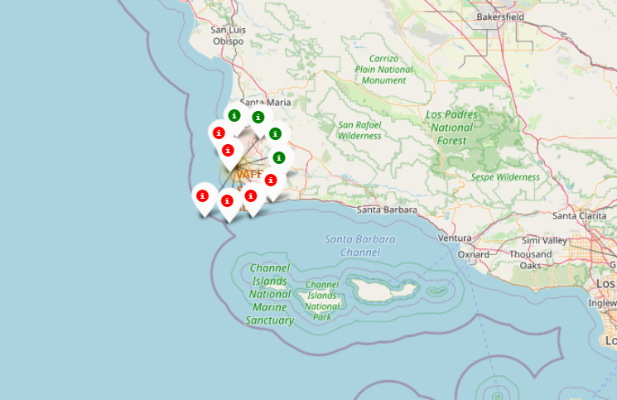
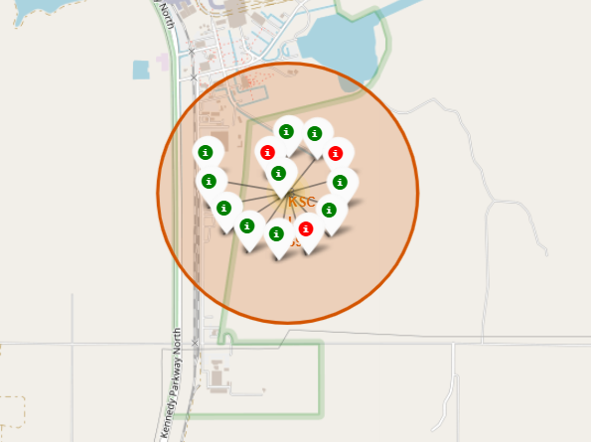
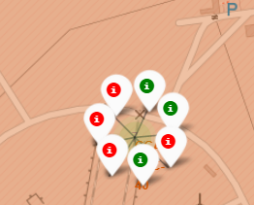
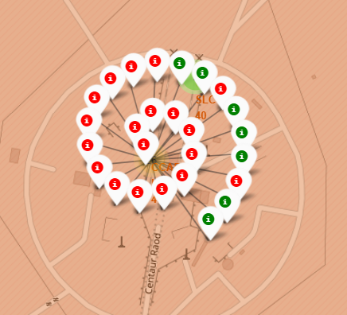
Launch Successes and Failures by Site
CCAFS SLC-40 has the greatest number of launches but more failure than success
KSC LC-39A has the greatest success rate

Slide 37
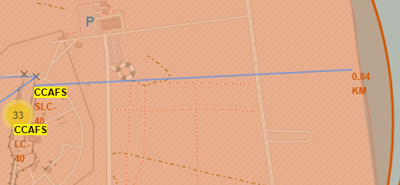
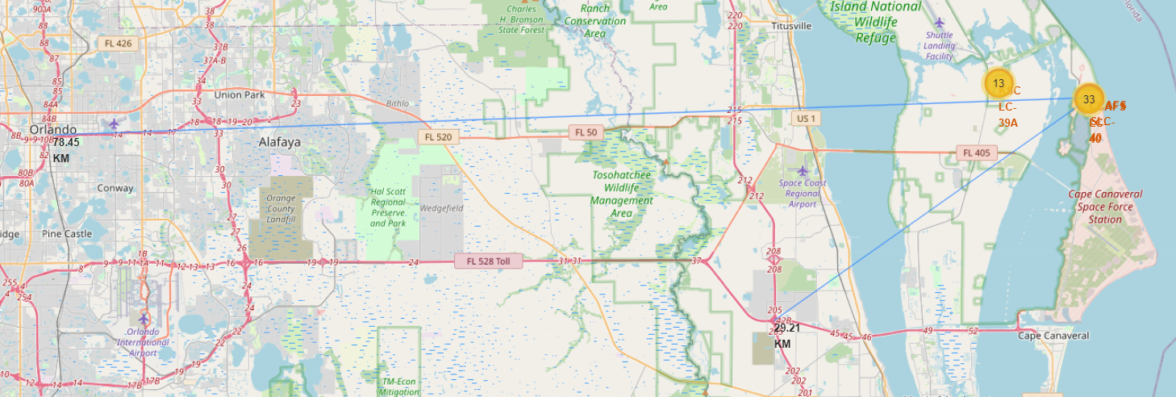
Proximity to coastlines, highways and cities
Launch sites are built close to the coastline and far away from the highway and city center

Slide 38


Slide 39
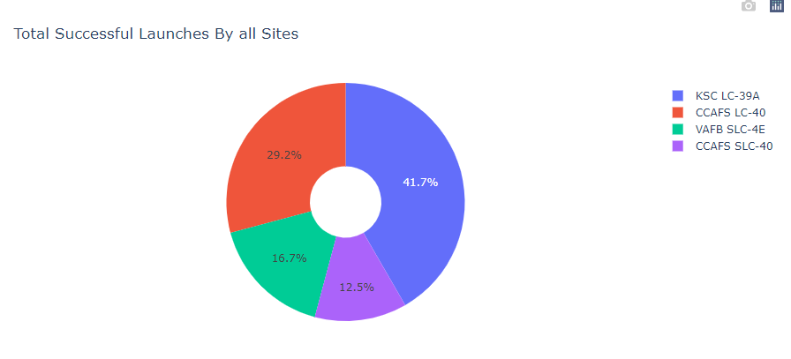
Total Successful Launches by Site
KSC LC-39A hosted the greatest proportion of successful launches at 41.7% whereas CCAFS SLC-40 hosted the smallest proportion at 12.5%

Slide 40
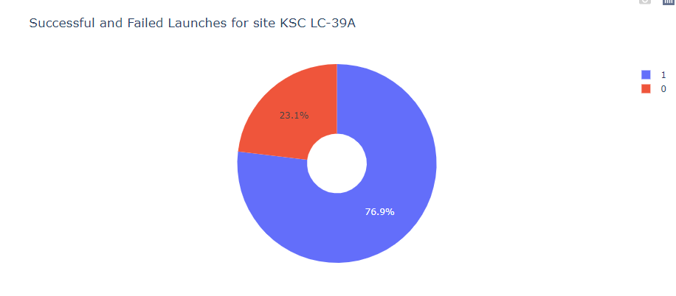
Most Successful Launch Site by Success Rate
Close to 77% of the launches at KSC LC-39A are successful

Slide 41
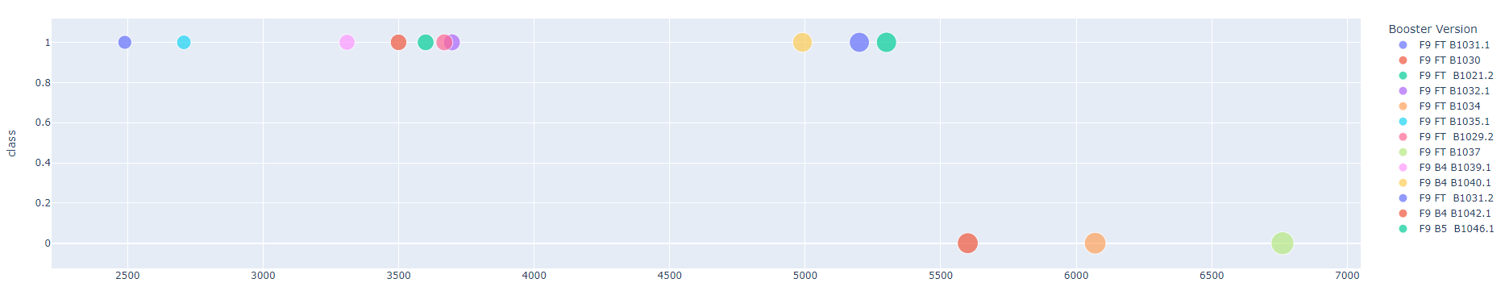
Success Rates of Different Boosters for different payloads
Each payload weight requires a different sub-version of booster.
The F9 FT booster covers the widest range of payload mass, from 2500kg to 6750kg
The F9 B5 booster has only been used for one payload mass at around 5300kg

Slide 42


Slide 43
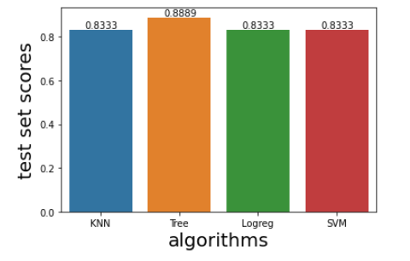
Classification Accuracy
The decision tree model has the highest accuracy rate of approximately 88.89%

Slide 44
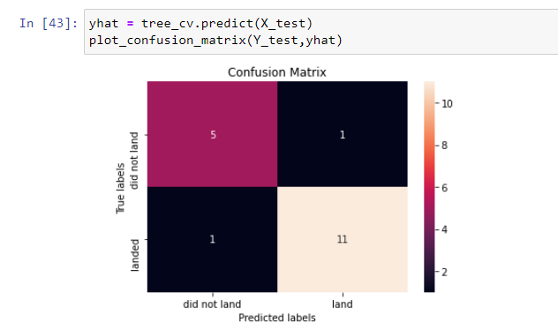
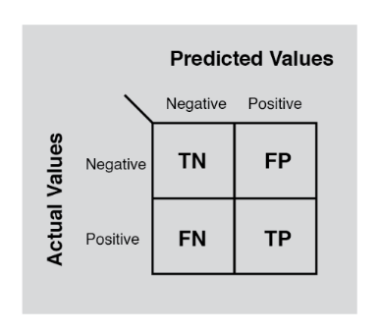
Confusion Matrix of the Decision Tree Model
The false positive rate is 16.66% being the higher classification error rate compared with the false negative rate of 8.33%

Slide 45
Conclusions
The decision tree model is the best for predicting the probability of successful landing of the first stage of a rocket launch – its main weakest is spotting false positive, i.e. predicting a success when the launch was a failure. However, the algorithms’ predictive accuracy is only marginally lower than the decision tree model’s
The launch site which contributed the most successful launches and have the highest successful launch rate is KSC LC-39A
Probability of success increases as payload mass decreases and as flight number increases
Launches aiming at these orbits are the most successful: ES-L1, GEO, HEO and SSO

Slide 46
Appendix
All codes, datasets can be found on my Github at https://github.com/azurecode1119/IBD-data-science-professional-certificate-capstone-project

Slide 47


